Slide 1
CSc 553 Principles of Compilation 09. Profiling and Profile-Guided Code Optimizations
Saumya Debray
The University of Arizona
Tucson, AZ 85721

Slide 2
Background: caches

Slide 3
Typical memory hierarchy structure
CPU
registers
Level 1 (L1) Data Cache (d-cache)
Level 1 (L1) Instruction Cache (i-cache)
Level 2 (L2) Cache
Level 3 (L3) Cache
RAM

Slide 4
Typical memory hierarchy structure
Intel i7-4770 (Haswell)
(data from 7-cpu.com)
CPU
registers
L1 latency:
4 cycles
32KB
32KB
Level 1 (L1) Data Cache (d-cache)
Level 1 (L1) Instruction Cache (i-cache)
L2 latency:
12 cycles
256KB
Level 2 (L2) Cache
L3 latency:
36 cycles
8 MB
Level 3 (L3) Cache
RAM latency:
230 cycles
RAM

Slide 5
Typical memory hierarchy structure
AMD Opteron A1170
(data from 7-cpu.com)
CPU
registers
L1 latency:
4 cycles
32KB
48KB
Level 1 (L1) Data Cache (d-cache)
Level 1 (L1) Instruction Cache (i-cache)
L2 latency:
18 cycles
1MB
Level 2 (L2) Cache
L3 latency:
60 cycles
8 MB
Level 3 (L3) Cache
RAM latency:
308 cycles
RAM

Slide 6
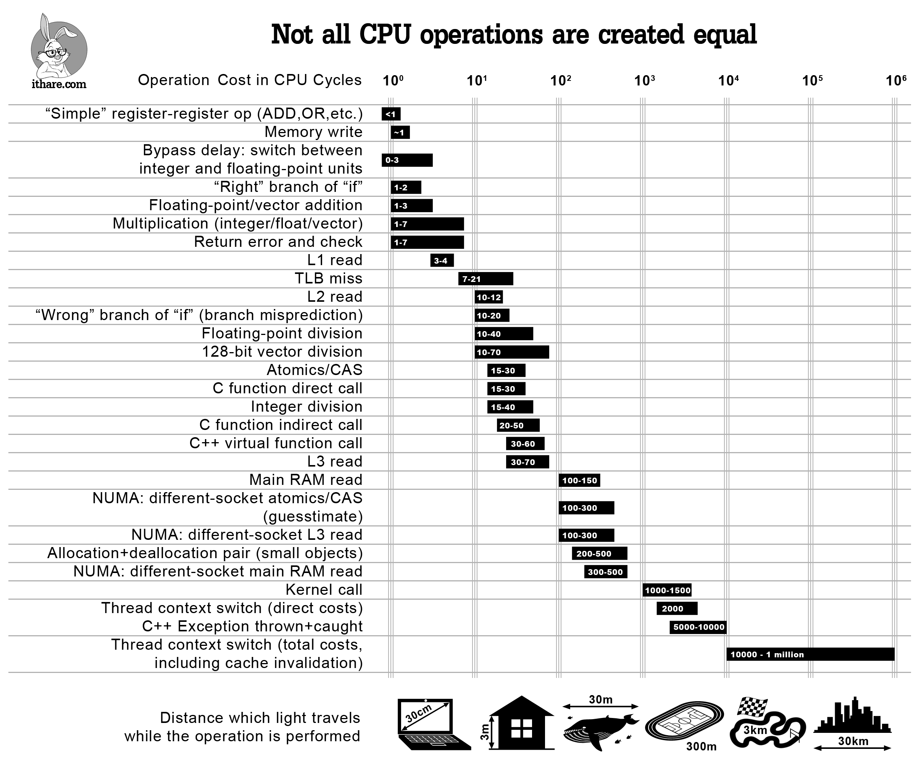

Slide 7
L1 instruction cache
Each cache access is to a "cache line" large enough to contain several instructions
The cache line that a memory address addr maps to is determined by selected bits of addr
conceptually similar to hashing
E.g., on Intel i7-4770 Haswell:
cache line size = 64 bytes
32 KB cache ⇒ 32 KB/64 = 512 cache lines
use 9 bits from the address to determine cache line
9 bits
addr:
14
6
63
5
0

Slide 8
L1 instruction cache
When fetching an instruction at address addr:
if addr is currently in L1 i-cache: fetch the contents from i-cache and execute
otherwise: cache miss at address addr:
a cache-line-sized block of memory containing address addr is loaded into the appropriate cache line
cost depends on where in the memory hierarchy that location is found
instruction at location addr brought into the CPU
the next few instructions will probably be found in the cache
the prior contents of that cache line are discarded
if any of the discarded instructions is executed again, that incurs another cache miss ("cache conflict")

Slide 9
Cache utilization issues
Cache misses due to instructions mapping to different cache lines
Cache conflicts due to instructions mapping into the same cache line
cache line 1
I1
I2
I3
I1
I2
I3
cache miss
cache line 1
cache conflict
cache line 2
J1
J2
J3

Slide 10
Profiling

Slide 11
Profiling
Knowledge of (relative) execution counts can be very useful for guiding optimization.
Heuristics usually give only crude estimates; often inaccurate.
Direct measurement (profiling) gives better results.
General approaches:
Sampling based: periodically samples the program counter (e.g., gprof).
Counter based: counts the number of occurrences of runtime events (e.g.: gcc –fprofile-generate/-fprofile-use)
For compiler optimization, counter-based profiling is more useful.

Slide 12
Examples of Counter-based Profiles
Basic block profiles
Counts the number of times each basic block is executed.
Edge profiles
Counts the number of times each control flow edge is taken.

Slide 13
Using Profiles in Compilation
Generate an instrumented executable.
Contains additional code to collect the profiles during execution, print them out at program exit.
Run the instrumented code on “typical” inputs.
Recompile the program, this time with the execution profile as an additional input.
The compiler uses the profile information to guide optimization decisions.
gcc –fprofile-generate
gcc –fprofile-use

Slide 14
Implementing Profiling
Allocate a 0-initialized counter for each entity (basic block, edge, …) being profiled.
Add code to update the appropriate counter when appropriate.
Basic block profiling: add code in the block to update the counter.
Edge profiling: “split” the edge by inserting a new basic block containing counter-update code.
Add code to write out the profiles at end of execution.

Slide 15
Code generation: Improving cache utilization

Slide 16
Improving i-cache utilization
Align the targets of frequently taken jumps and calls on cache line boundaries
add no-ops above the target if necessary
gcc: -falign-functions, -falign-loops, -falign-jumps
jmp
cache line size
unutilized portion of cache line
Put frequently-executed-together code close together in memory
puts groups of such instructions into the same cache line where possible
reduces the no. of cache misses

Slide 17
Profile-Guided Code Layout
Goal: improve memory hierarchy (esp. i-cache) performance by careful code layout.
Intuition: convert temporal locality to spatial locality.
Code that is executed close together in time gets placed closed together in memory.
This helps reduce cache conflicts and improves prefetching behavior.
Information needed: most likely outcome for each conditional branch
execution frequency of edges in the control flow graph

Slide 18
Code Transformations for Layout
Procedure positioning
the relative order of procedures in a program.
Basic block positioning
The relative order of basic blocks within the code for a procedure.
Procedure splitting
Place “hot code” within a procedure far away from the “cold code.”

Slide 19
Procedure Positioning
General idea: if p calls q frequently, they should be placed close together in memory.
Benefits:
The need for “long branch” instructions is reduced.
Assuming p and q end up on the same page, the amount of paging is reduced.
Data structure: weighted call graph. This is an undirected graph where:
each vertex is a procedure in the program; and
There is an edge (p, q) with weight k if there are k calls between p and q (from the program’s profile).

Slide 20
Procedure Positioning: Cluster Graphs
Given a call graph G for a program P, construct a cluster graph G' = (V ', E '):
Each vertex in G' is a set (cluster) of procedures of P.
Initially:
each procedure is in a cluster containing only itself.
edges in G' are derived from the edges in the call graph G.

Slide 21
Procedure Positioning: Algorithm
Carry out node merging on the cluster graph:
while E ' ≠ ∅:
Find a heaviest edge e ≡ (a, b) ∈ E ';
merge clusters a and b, remembering the order of merges;
delete e from E ', update other edge weighs accordingly.

Slide 22
Procedure Positioning: Algorithm (cont’d)
Generate a procedure placement ordering:
Initially, Order = ε;
Consider the vertices in the order in which they were added to the cluster.
For each vertex v, attach v to whichever end of Order the vertex v has a higher edge weight to (in the original call graph for the program).

Slide 23
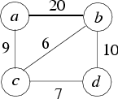
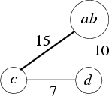


Procedure Ordering: Example
Initial cluster graph:
After merging {a}, {b}:
After merging {a,b}, {c}:
After merging {a,b,c}, {d}:
Final procedure layout: | c, a, b, d
From the original call graph, c prefers to be closer to a than to b; d prefers to be near b.

Slide 24
EXERCISE
Work out a good procedure placement ordering given the following weighted call graph:
40
a
20
b
20
c
100
10
25
50
d
e

Slide 25
EXERCISE - solution
40
40
40
a
20
b
20
c
45
b
20
ad
45
be
30
c
ad
c
100
25
50
10
50
10
d
e
e
Layout order: ad
70
ad
be
c
c
be
ad
be
c

Slide 26
EXERCISE
Work out a good procedure placement ordering given the following weighted call graph:
p
96
20
9
q
r
35
27
8
v
16
17
s
t
u
11
52
20
w

Slide 27
Procedure Positioning: Effects
Speed improvement: up to ~10%.
Long branch instructions:
Static count: increases significantly (~65–400%).
Dynamic count: the no. of long branch instructions executed decreases by 80–98%.
Profile-guided code positioning improves the behavior of “hot” code even though it could adversely affect “cold” code.
Memory hierarchy:
no data presented in paper
authors claim it improves paging, TLB, and i-cache performance.

Slide 28
Basic block ordering
General idea:
if block B is executed soon after block A, place B close to A in memory.
Equivalent formulation:
orient branches to maximize the not-taken (I.e., fall through) case;
eliminate unconditional branches if possible.
common path
common path
A
⇒
A
C
B
B
C
common path
common path
A
⇒
A
C
B
B
C

Slide 29
Example
int strlen(char *str) {
len = 0;
while (str != NULL && *str != '\0') {
len += 1;
str += 1;
}
return len;
}
B0
len = 0
B1
p == NULL?
Code Layout
Unoptimized | Optimized
B0
B1
B2
B3
B4
F
B3
T
*p == '\0'?
B0
T
F
B1
B4
B2
return len
len += 1
str += 1
B3
B4
B2
frequently taken edges

Slide 30
EXERCISE
What is a good basic block order for the following weighted control flow graph? (Edge weights represent execution counts.)
A
40
100
B
C
40
100
D
90
50
E
F
90
50
G

Slide 31
Basic Block Ordering: Algorithm
Compute an edge profile for the program.
Process the edges in descending order of execution count:
For each edge e, chain e if possible; else discard.
This results in a collection of chains of basic blocks
Concatenate these chains together to get the final basic block order.

Slide 32
Basic Block Ordering: Chaining edges
Given a set of chains S; an edge e ≡ a → b (a ≠ b):
if neither a nor b belongs to any chain in S:
Start a new chain containing only e; add this to S.
else if an existing edge C ∈ S can be extended using e (i.e., C ends with a or begins with b), then extend C with e:
If C ≡ 'b → …' then extended C ≡ 'a → b → …'
If C ≡ '… → a' then extended C ≡ '… → a → b'
else discard e.

Slide 33
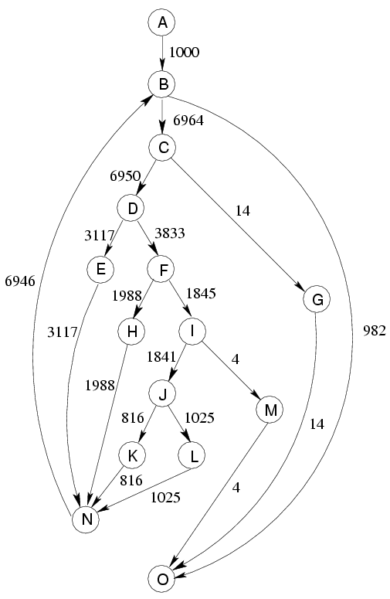
Basic Block Ordering: Example
From: “Profile-Guided Code Positioning” by Pettis and Hansen, Proc. PLDI 1990.
Initial control flow graph

Slide 34
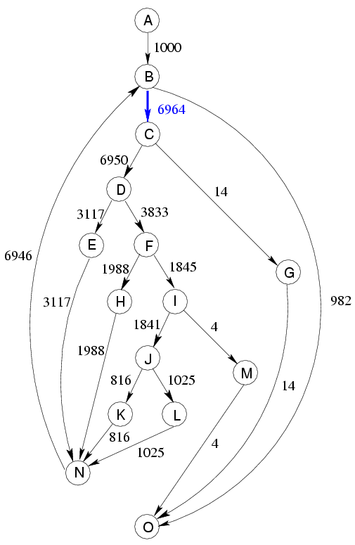
Basic Block Ordering: Example
Step 1:
current chains:
none
current edge: B → C
action: new chain

Slide 35
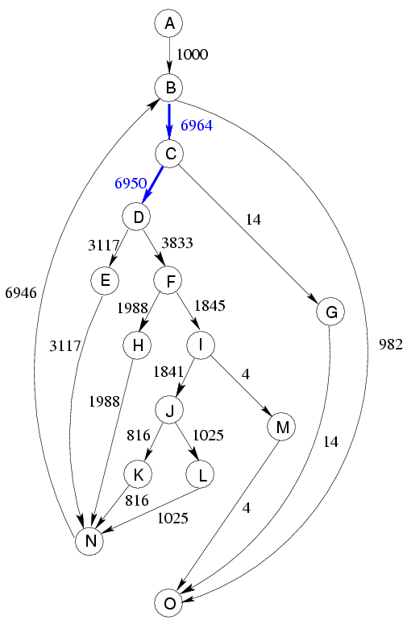
Basic Block Ordering: Example
Step 2:
current chains:
B → C
current edge: C → D
action: attach to chain

Slide 36
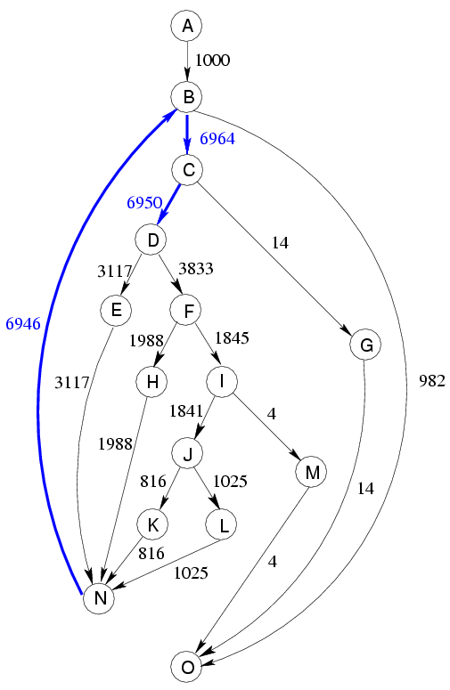
Basic Block Ordering: Example
Step 3:
current chains:
B → C → D
current edge: N → B
action: attach to chain

Slide 37
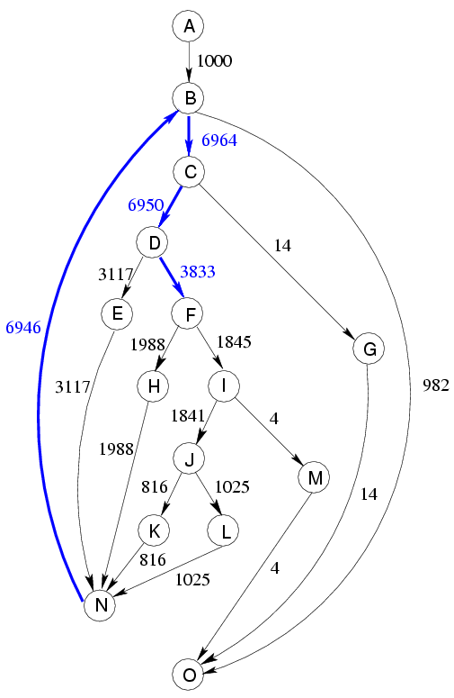
Basic Block Ordering: Example
Step 4:
current chains:
N → B → C → D
current edge: D → F
action: add to chain

Slide 38
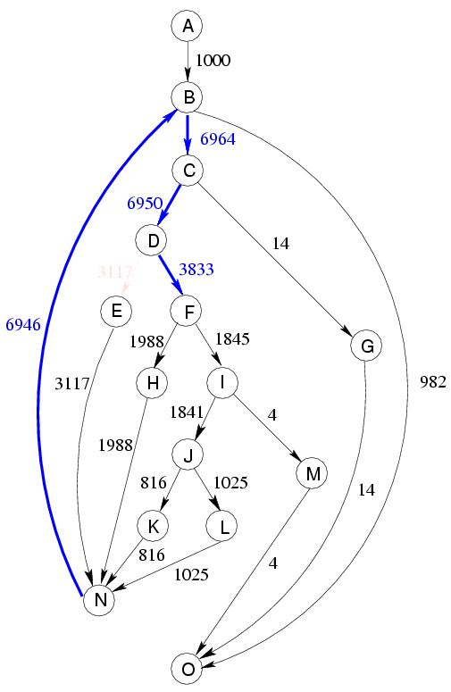
Basic Block Ordering: Example
Step 5:
current chains:
N → B → C → D → F
current edge: D → E
action: discard

Slide 39
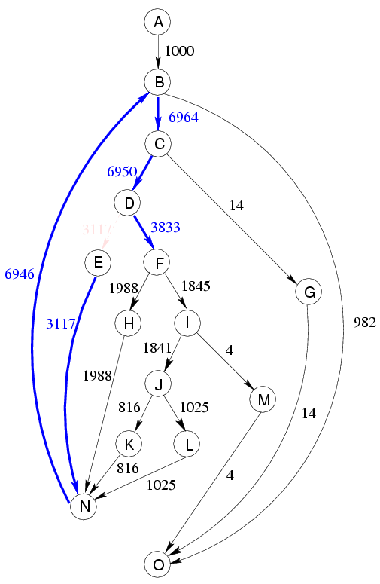
Basic Block Ordering: Example
Step 6:
current chains:
N → B → C → D → F
current edge: E → N
action: add to chain

Slide 40
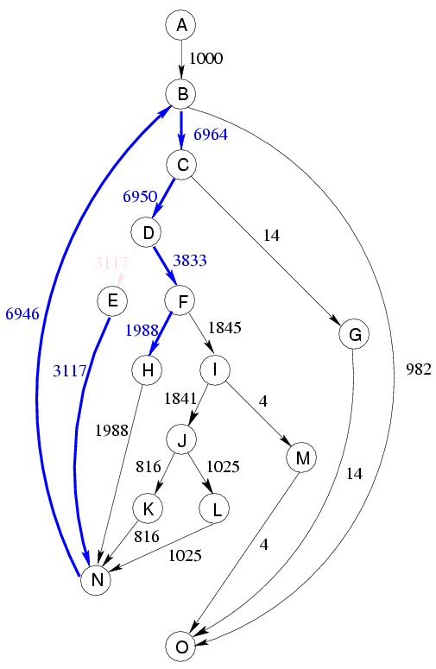
Basic Block Ordering: Example
Step 7:
current chains:
E → N → B → C → D → F
current edge: F → H
action: add to chain

Slide 41
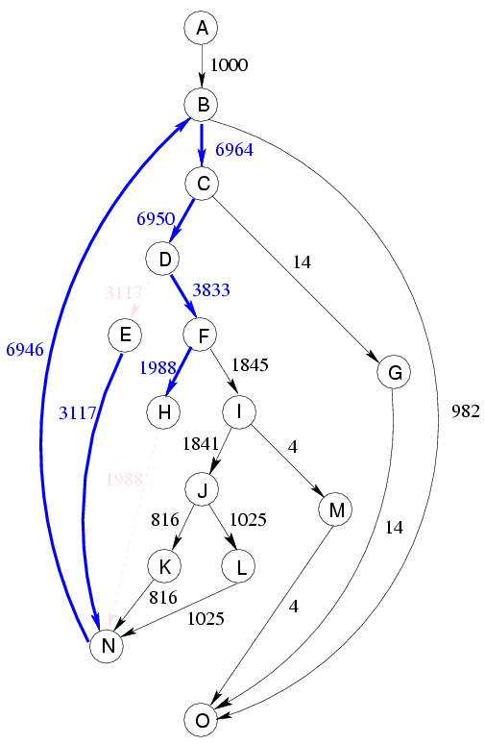
Basic Block Ordering: Example
Step 8:
current chains:
E → N → B → C → D → F → H
current edge: H → N
action: discard

Slide 42
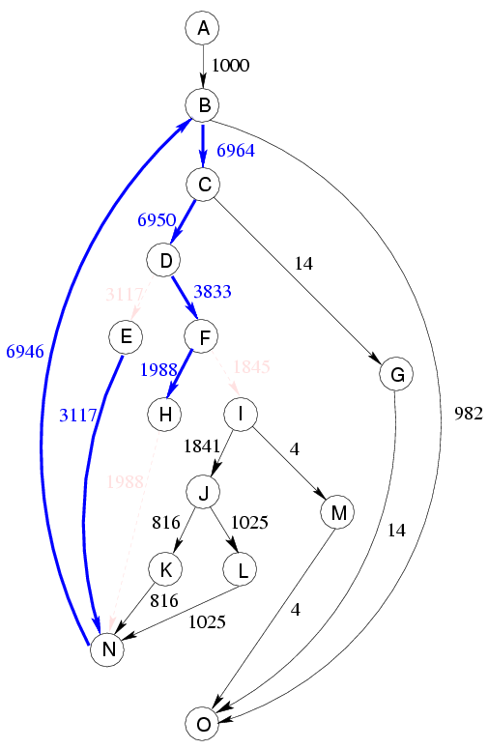
Basic Block Ordering: Example
Step 9:
current chains:
E → N → B → C → D → F → H
current edge: F → I
action: discard

Slide 43

Basic Block Ordering: Example
Step 10:
current chains:
E → N → B → C → D → F → H
current edge: I → J
action: new chain

Slide 44
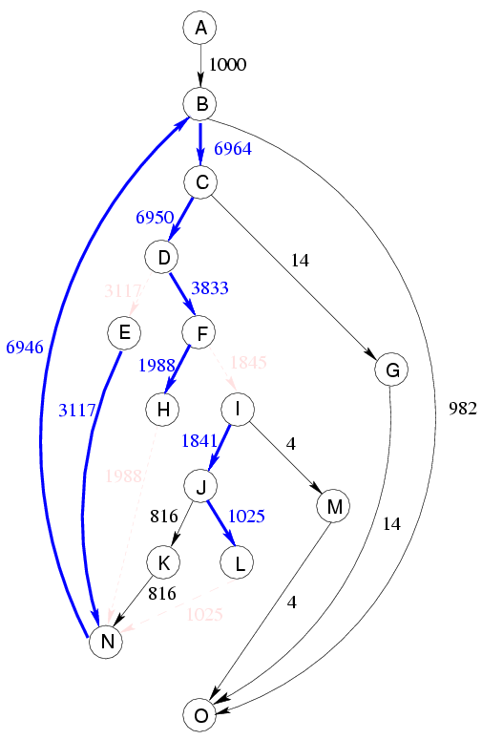
Basic Block Ordering: Example
Step 11:
current chains:
E → N → B → C → D → F → H
I → J
current edge: J → L
action: attach to chain

Slide 45
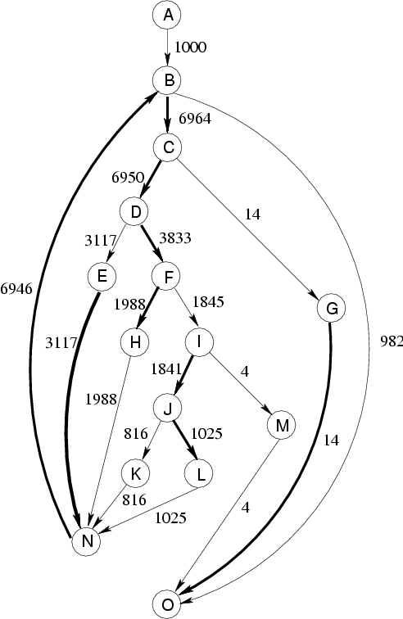
Basic Block Ordering: Example
Final:
current chains:
E → N → B → C → D → F → H
I → J → L
G → O
Final layout:
A, E-N-B-C-D-F-H, I-J-L, G-O, K, M

Slide 46
EXERCISE
Work out a good procedure placement ordering given the following weighted call graph:
a
40
10
c
b
30
40
30
60
80
30
d
e
20
0
f
40
10
g

Slide 47
Basic Block Ordering: Effects
[from Pettis-Hansen, PLDI ’90]:
Speed improvement: 0.6% to 16.2%
Together with procedure positioning: 2.1% to 20.3%
Basic block positioning, by itself, can still incur cache conflicts between blocks from different functions. Combining it with procedure placement fixes this.
Other improvements:
significant reduction in i-cache misses
significant decrease in branch misprediction penalty cycles
small reduction in the no. of instructions executed
This happens because we don’t have to jump around cold code interspersed with the hot code.

Slide 48
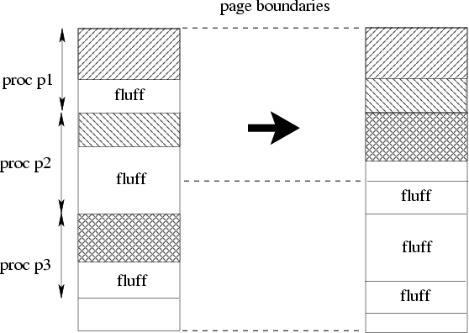
Procedure Splitting
Effects of basic block ordering for a function:
frequently executed blocks moved to the beginning;
infrequently executed code moved to the end.
Procedure splitting:
moves blocks with execution count = 0 (“fluff blocks”) to a separate page.

Slide 49
Procedure Splitting: Issues and Effects
Issue:
after procedure splitting, some blocks may be so far away that they cannot be reached with a “short branch” instruction.
Solution: place a stub block in the non-fluff code that uses a “long branch” to jump to the target.
Effects:
magnifies the effects of basic block and procedure placement by further improving locality.
Speed improvements with all three transformations [Pettis & Hansen, PLDI ’90]: 2.1% to 26.0%.

